Slide 1

Programming Language Processing
Machine Learning for Source Code Understanding and Generation
Saikat Chakraborty
Ph.D. Candidate
Columbia University, New York
Notes:
Hi everyone, today I am going to present my research work on Programming Language Processing. In particular, I am going to talk about Machine learning for source code understanding and source code generation. I am Saikat, Ph.D. candidate at Columbia University.

Slide 2



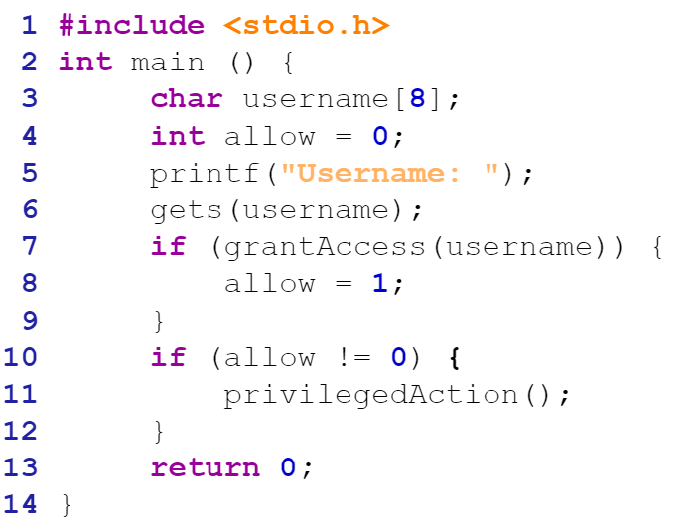



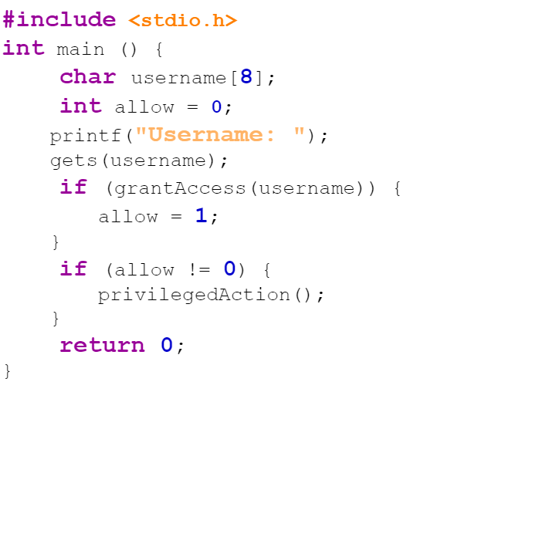
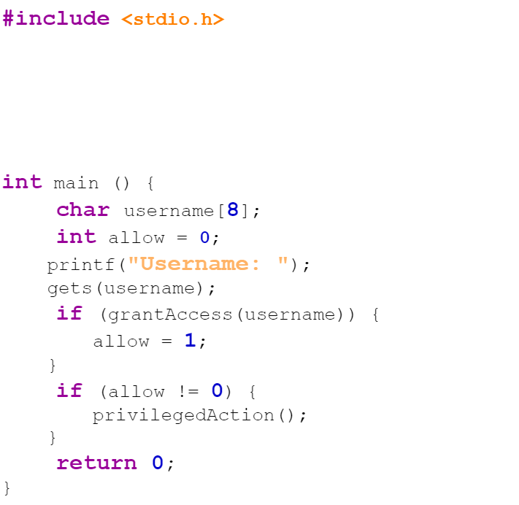
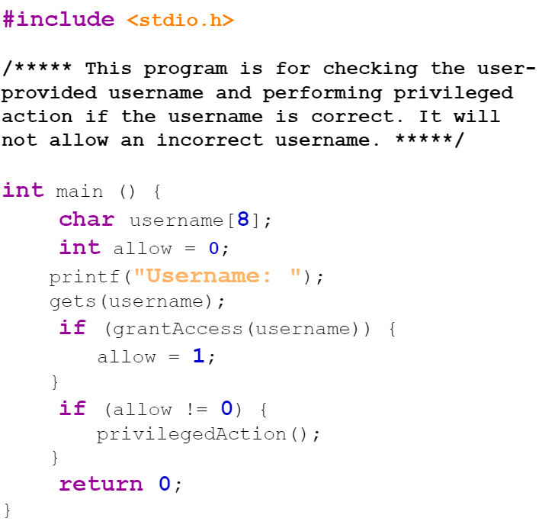
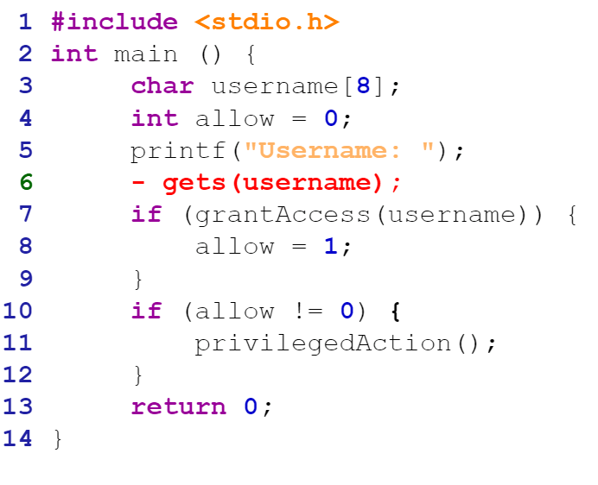


Alice
Bob
Test
Coding
Document
Bug
Finding
Bug Fix
https://thenewstack.io/how-much-time-do-developers-spend-actually-writing-code/
Notes:
Before moving details into the talk, let me introduce you to Alice and Bob. They are two of the most talented and phenomenal programmers working on cutting edge technologies.
Coding is a big part of their daily routine. They spend a lot of time writing code,
After that, they write test cases for Testing whether their code is okay.
If a test fails, they analyze their code for finding bugs.
Once a bug is found, they fix it, by editing the code.
Finally, they have to write documentation for the code to ensure the maintainability of their code. As we can see from a typical daily activities of programmers, they spend a lot of time dealing with source code. In fact, an online survey reports programmers spend
67% of their time on average dealing with source code. Some of these tasks they do can be very repetitive and thus amenable to automation.

Slide 3




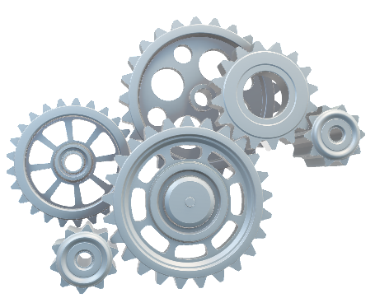
My Research Interest
Code Summarization
Code Editing/ Repair
Bug Detection
Code Search
Code Generation / Synthesis
Other Source Code Analysis
3
Notes:
And that bring my research into context. I am interested in building automation tools to increase developers productivity. Over the years, I have been working on different such automation problems. In particular, I have explored
Code Generation
Bug Detection
Code summarization
Code Editing/Repair
Code Search
And Other source code analysis. Now, before moving onto further details into my talk, let us see some potential ways to build automation tools for some of these problems.

Slide 4
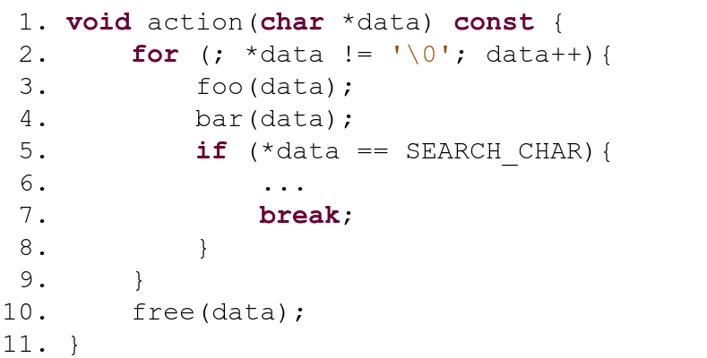
Identify Bugs
x = parameter(free)
Y = trace_in_dataflow(x)
if x or y is modified:
WARNING!!
[e.g., Alloy model checking, KLEE, SAGE, Cute, AFL Fuzzers, Java Path Finder, LLVM Passes]
4
Notes:
Let us consider bug detection in source code. If we want to detect bug in this piece of code,
a traditional bug finding tool would need to know the oracle / bug pattern or any specification articulating the bug.
An static analyzer based bug finder will probably need such an specification or pattern written in a domain specific language.

Slide 5
Automated Edit / Program Repair
l = location(gets)
v = parameters(gets)
s = memory_size(v)
new_stmt = “fgets (v, s, stdin)”
Update l with new_stmt
[1] Simfix Jiang et.al. 2018
[2] Elixir Saha et.al.2017]
5
Notes:
In another task. Suppose we are trying to build an automatic code editor.
In particular, we are aiming for applying this code edit pattern.
In this case, as well, we probably would write the edit pattern algorithm using a DSL.

Slide 6
Pattern/Rule Based Automation
Too Many Different Patterns [4]
Low tolerance for Deviation[3]
l = location(gets)
v = parameters(gets)
s = memory_size(v)
new_stmt = “fgets (v, s, stdin)”
Update l with new_stmt
x = parameter(free)
Y = trace_in_dataflow(x)
if x or y is modified:
WARNING!!
[3] Johnson et. al. 2013
[4] Saha et. al. 2017
6
Notes:
While these pattern or specification based automations are plausible solution for a lot of these automation tasks and have been helping developers last few decades, there are some potential problems in these approaches.
First, If we write the specifications in a very strict way, the analyzer may miss a lot of slight deviation, thus may cause high FALSE NEGATIVES. In contrast, very loose specification may cause HIGH FALSE NEGATIVES.
Even if we find the right amonut of tightness in the specification, there are simply too many such patterns or specifications to write.

Slide 7
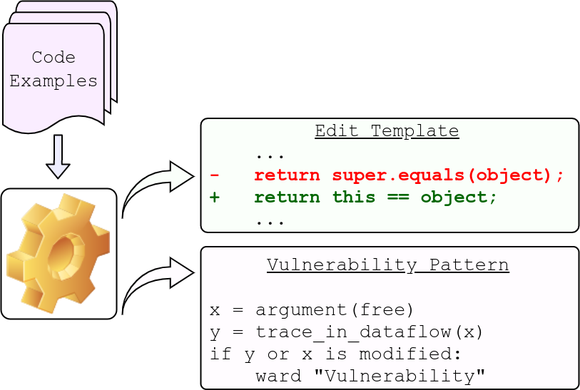
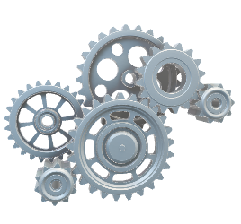
Data-Driven Automation
x = parameter(free)
Y = trace_in_dataflow(x)
if x or y is modified:
WARNING!!
l = location(gets)
v = parameters(gets)
s = memory_size(v)
new_stmt = “fgets (v, s, stdin)”
Update l with new_stmt
7
Notes:
In contrast, we can go for data driven automation. That is, we can LEARN these specification from large quantity of data.

Slide 8

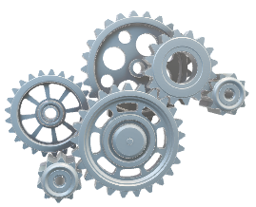
Data-Driven Automation – Specification Mining
x = parameter(free)
Y = trace_in_dataflow(x)
if x or y is modified:
WARNING!!
l = location(gets)
v = parameters(gets)
s = memory_size(v)
new_stmt = “fgets (v, s, stdin)”
Update l with new_stmt
[5] Pradel et. al. 2012
[6] Le et. al. 2018
[7] Meng et. al. 2017
8
Notes:
One way towards such data driven automation is to
MINE or discover these specifications from examples
and
subsequently using analyzer to run on these mined specifications. While this approach really paves the way for data-automation into development pipeline,
it still requires manually writing the analyzer or using preexisting analyzer. In contrast to this approach,

Slide 9
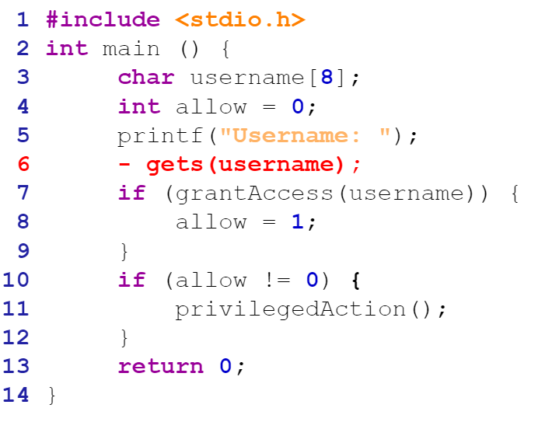
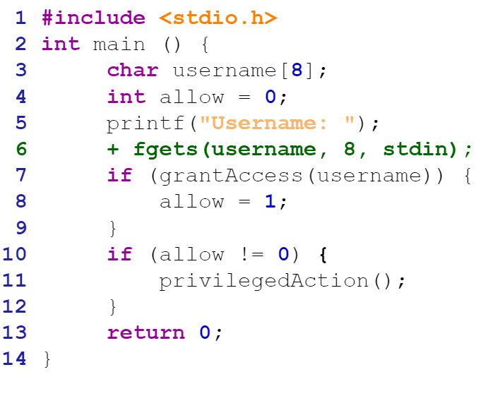
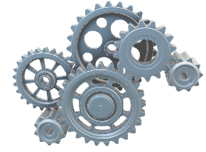
Data-Driven Automation – Automated Analyzer
9
Notes:
We can build a AI based tool, which acts both as such specification miner and analyzer.

Slide 10
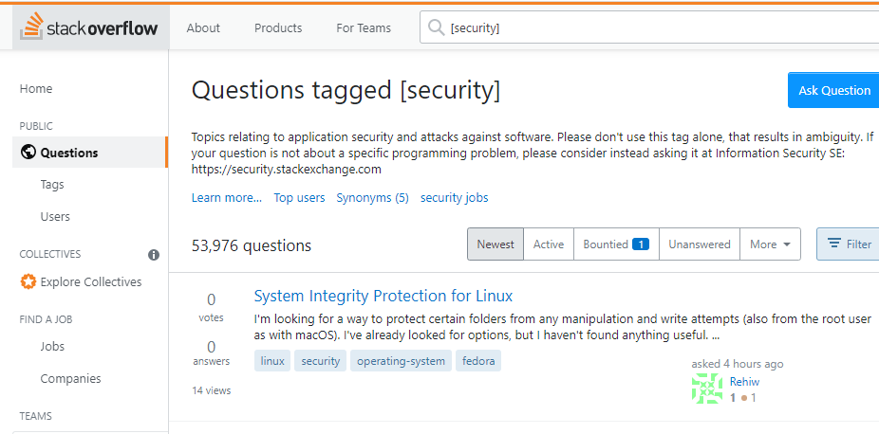
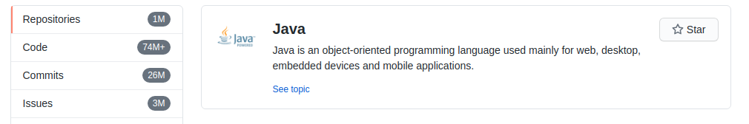
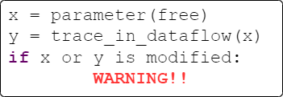

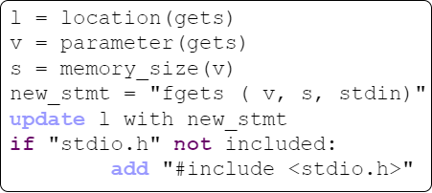


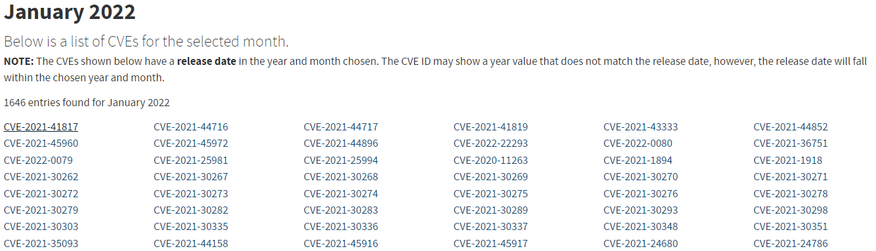




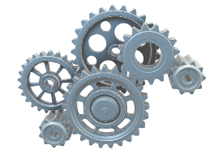
Data-Driven Automation – Automated Analyzer
10
Notes:
This data driven automation is feasible and plausible because of the large amount of data available in open source repositories and software databases. For examples, Github, Bitbucket, JIRA, Bugzilla, National Vulnerability database contain enormous amount of data to train machines for automating those tasks.

Slide 11


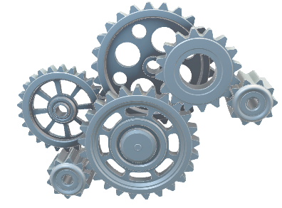
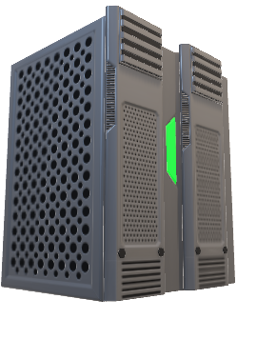
Artificial Intelligence for Software Engineering
Curate and Preprocess
Data
Design
Model
Training
AI-based
Automation Tool
11
Notes:
Thus my research focus is on Artificial Intelligence for Software Engineering. I have been trying to build toos for such automation. In particular, in my research I
Curate, and preprocess data from these sources.
Design appropriate model based on the requirement of the task at hand. My primary focus is to design the models in a way that these can identify patterns, albeit implicitly, and apply those patterns in appropriate scenario.
Design the training objective and train the model.
And finally deploy and analyze the performance of such tool.

Slide 12
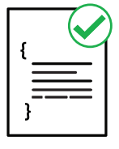

Challenges of AI for SE
Understanding
Source Code
Generating Source Code
Understanding Structure
And Functionality of Source Code
Ensuring the Syntactic and Semantic Correctness for Generating Source Code
12
Notes:
Let us now look at the challenges AI in SE. In particular, let us look at challenges that a model face while dealing with source code. I view two major challenges.
First challenge is understanding the source code, in order for the model to properly understand the source code, the model may need to analyze the formal properties of source code that is the syntax and semantics.
Another challenge for the model is generating source code. Here if we want a model to generate source code, it must maintain, at least empirically, the syntactic and semantic correctness of the source code. My research field

Slide 13

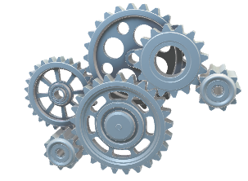
Programming Language Processing
Program Analysis
Machine Learning
13
Notes:
Programming Language Processing, PLP, in short, is aimed at solving those two classes of challenges. Where I leverage both traditional program analysis and machine learning to build automation tool for programmers. Now let us look at some of the example application that we expect to automate with PLP

Slide 14
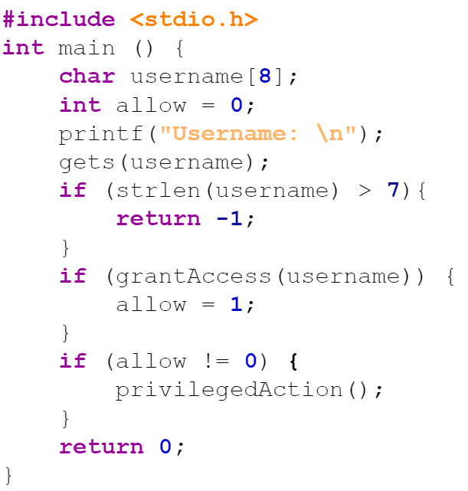
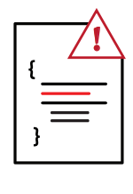
Code Understanding Task - Example
Understand Source Code
Vulnerability Detection
14
Notes:
Here is a task of vulnerability detection from source code. Here, we formulate the problem as a code classification task.
Needless to say, to properly do so, the model should understand and reason about the input code.

Slide 15
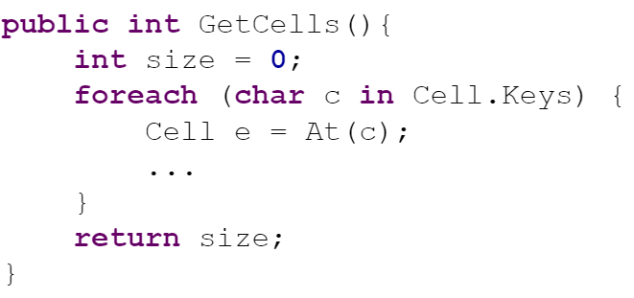
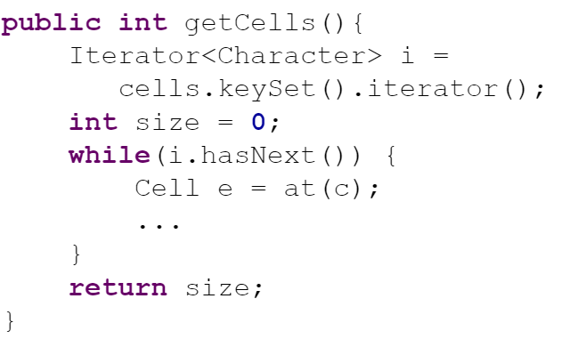
Code Generation Tasks - Example
Code Translation
Generate Source Code
Code Editing/
Program Repair
15
Notes:
Here we see few examples where we want a model to generate source code
First, Code translation to translate from one PL to another.
Another task is automated Code editing or program repair. Here we learn the code edit patterns and given a buggy code, the model generates the fixed code.
Obviously here, the model should know how to generate the code. Now that we saw the examples, let us look at the properties that the model should exhibit.

Slide 16
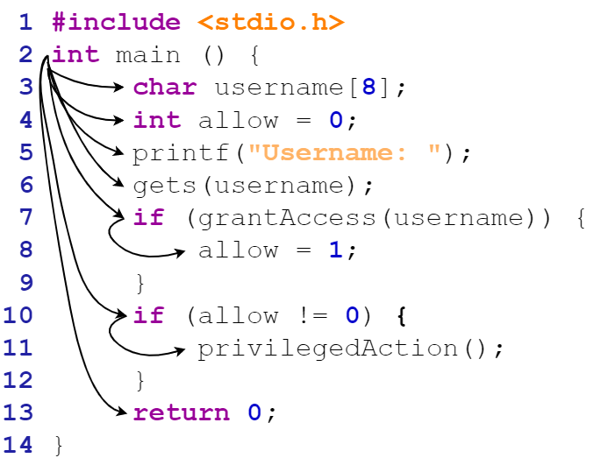
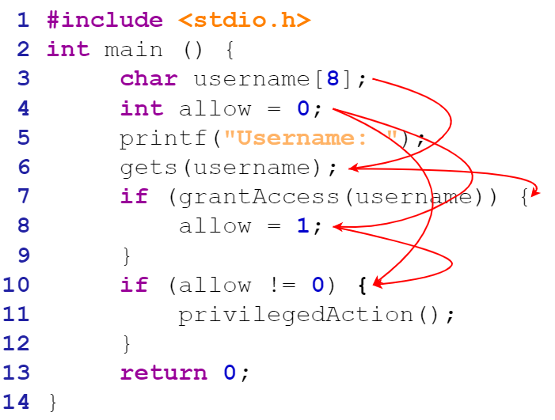
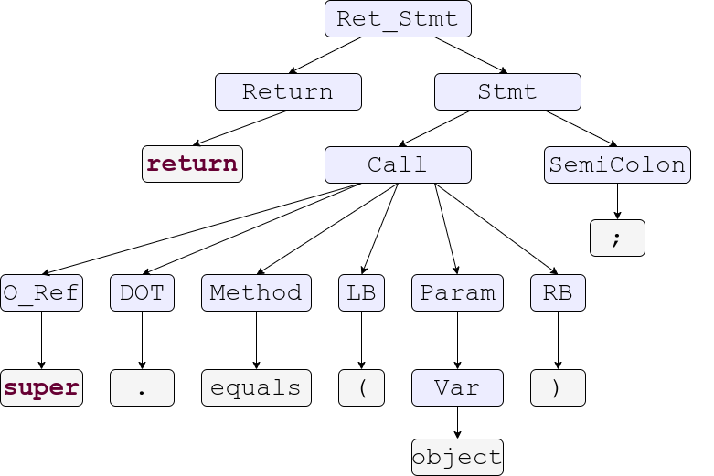
Understanding Source Code - Requirement
Control Dependency
Syntax Structure
Data Dependency
16
Notes:
A model trying to understand the input source code should understand the basic structure of the input code,
that is the syntax structure, the syntax tree or the abstract syntax tree.
Beyond that, the model should understand the semantic structure consisting of Control Dependencies
Data dependencies, etc.

Slide 17
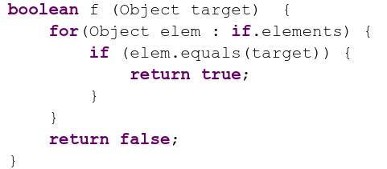
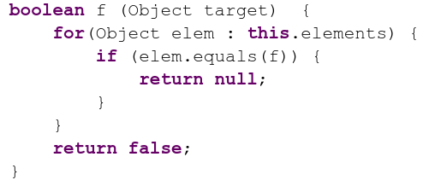
Generating Source Code - Requirement
Syntactic correctness. 2. Semantic correctness.
Syntactically Incorrect
Semantically Incorrect
17
Notes:
On the other hand, a model trying to generate source code should maintain the syntactic correctness and semantic correctness of generated code.
We do not want the model to generate this code. Because, even though this code is almost completely correct,
One mistake here makes it almost completely useless.
Neither do we want the model to generate this code.
Because, even though this code is syntactically correct,
Some of the components of this code violates semantic constraints. With all these requirements known, I research ambition is to

Slide 18
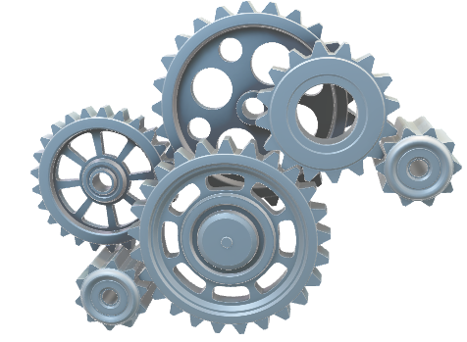
Programming Language Processing
Syntax
Encoding
Semantics
18
Notes:
encode the knowledge and constraints specific to Programming languages into models.

Slide 19
Encoding Syntax and Semantics
Syntax
Code Modeling
Explicit Encoding
Implicit Encoding
Natural Channel Mutation
Formal Channel Mutation
Ways of Encoding
Semantics
19
Notes:
In my research experience, I see several ways to do so. On one hand, we can explicitly design models to exhibit PL specific constraints. On the other hand, we can implicitly learn these constraints from large amount of data. I have worked on both of these directions. And in today’s talk, I will discuss some of my works in these directions. Is there is clarification question so far?

Slide 20
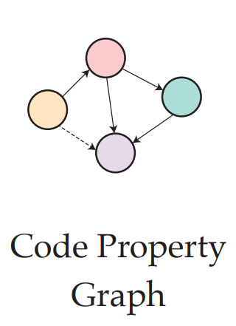
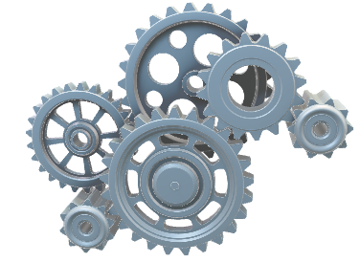
Explicit Encoding
Code Modeling
Explicit Encoding
Implicit Encoding
Natural Channel Mutation
Formal Channel Mutation
[8] Learning to Represent Program as Graphs
Allamanis et. al. 2017
[9] Learning to Represent Edits
Yin et. al. 2019
[10] HOPPITY – Dinella et. al. 2020
20
Notes:
First off, the explicit encoding.
In this approach, we specifically design the model to address the PL constraints or PL specific properties. There are a lot of related works in last few years in this direction. Let us look at some of my work in this direction.

Slide 21
CODIT: Code Editing with Tree Based Neural Models (TSE’20) Explicit Encoding of Code Structure for Code Edit
21
Notes:
Let us look at CODIT, Code Editing with Tree Based Neural Models.

Slide 22
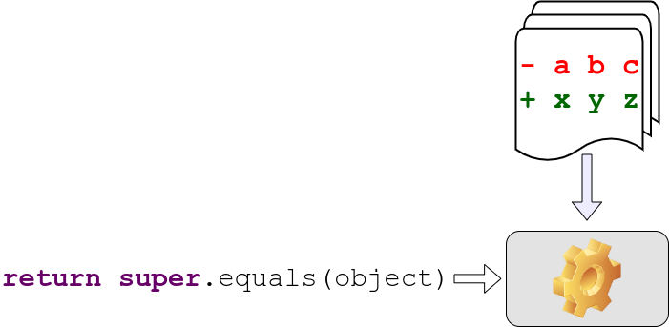
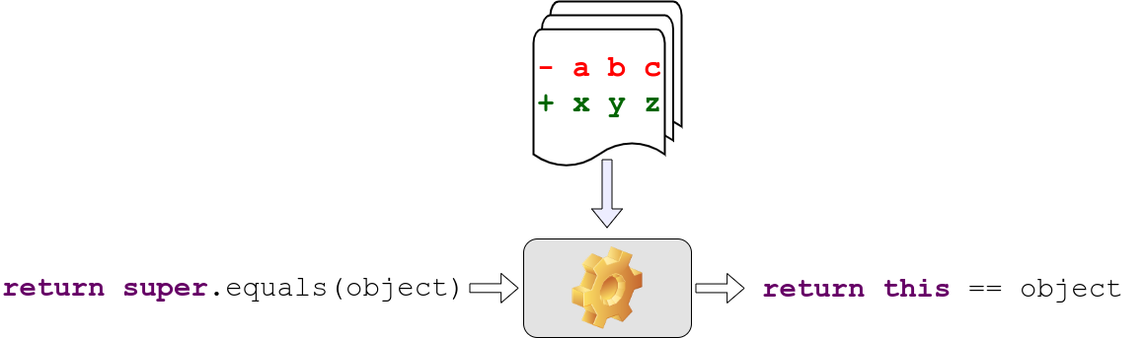
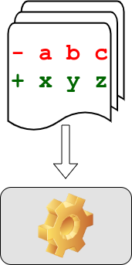
Automated Code Editing
Example Code Edits
Code Before Edit
Code After Edit
22
Notes:
Here we formulate the problem as
training a model to learn the frequent edit patterns. Once such a model is trained.
It will take the code before edit And
Generate the code after edit.

Slide 23
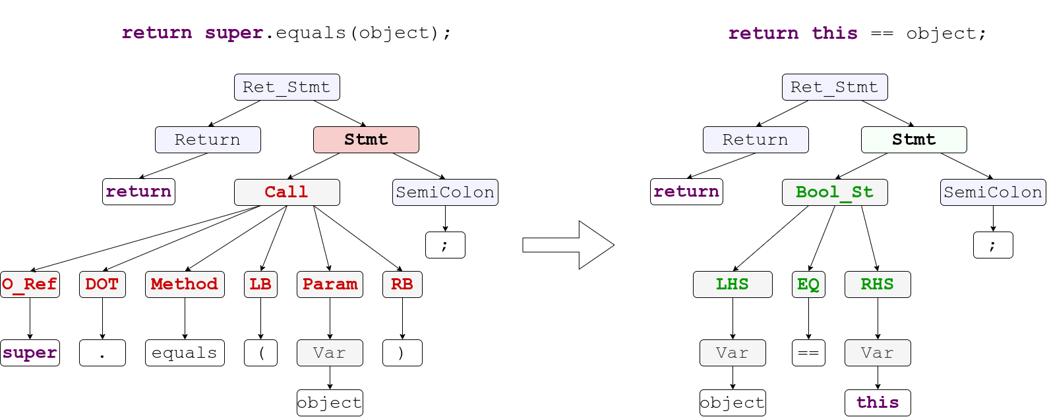
CODIT: Code Editing With Tree Based Models
Code Before Edit
Code After Edit
23
Notes:
This is our first approach for this automation. And here our goal is to generate syntactically correct code. To ensure the syntactic correctness, we design a Tree Based model for code generation.
Concretely, Given the code before edit,
We extract the syntax tree out of it.
We then design a tree translation model to translate the syntax tree
And finally we generate the edited code from the syntax tree. As we will see later, Codit works in two steps.
In first step, Codit translates the structure, and
in second step Codit generates the Edited code.

Slide 24
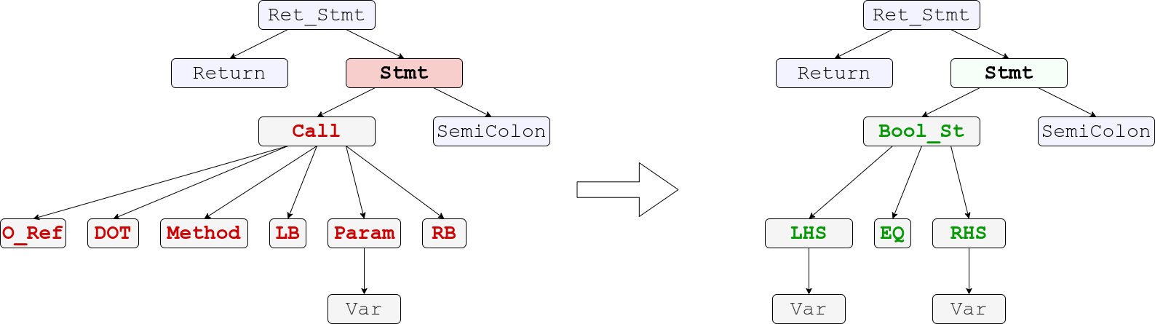
CODIT Step 1 : Tree Translation
24
Notes:
In the first step of CODIT, our goal is to translate the structure of the code. Our motivation to do such is if we can generate structure of the edited code, we don’t have to worry about the syntactic correctness. Nevertheless, let us see how to achieve such translation.

Slide 25
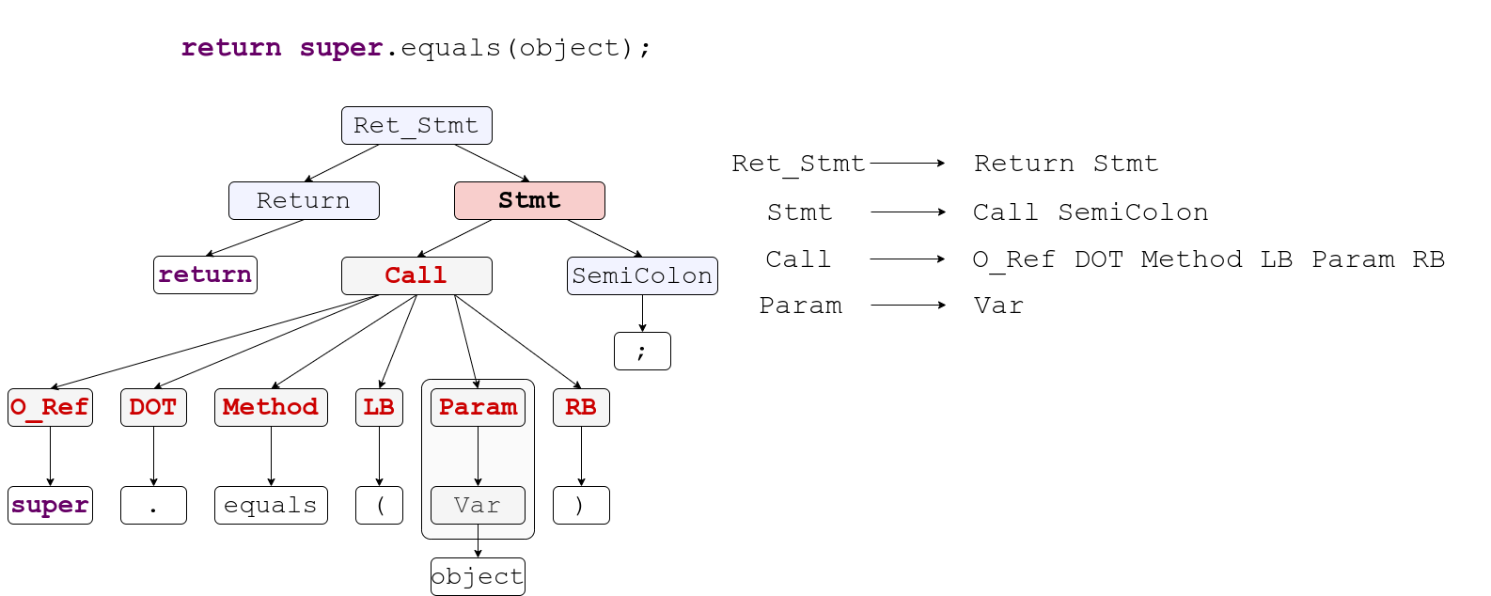
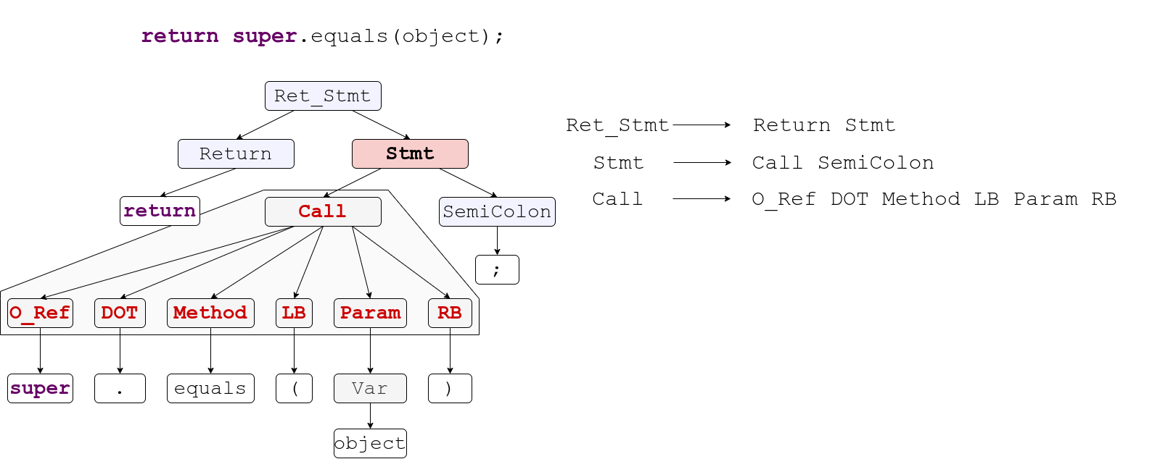
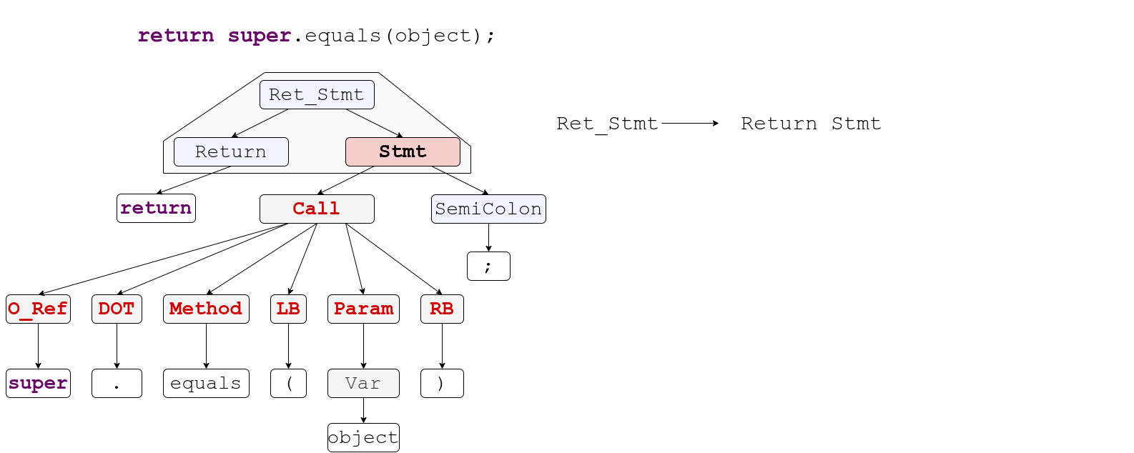
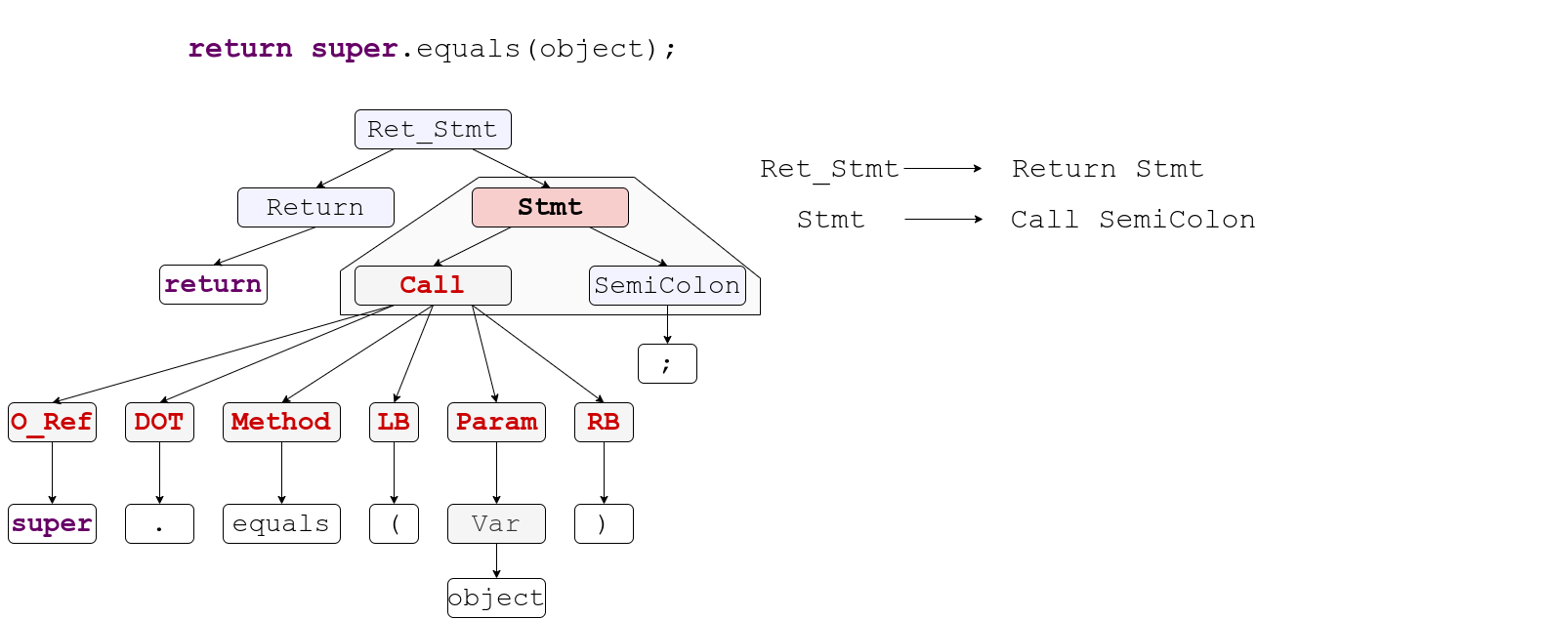
CODIT Step 1 :Tree Translation
25
Notes:
Our first challenge is to encode the syntax tree so that it is consumable by a model. To encode the syntax tree, we flatten out the tree STRUCTURE as a sequence of production rules from the context free grammar of the programming language. These rules,
If applied sequentially
To the root node in a left derivation fashion would generate the syntax structure
Of the corresponding code.

Slide 26
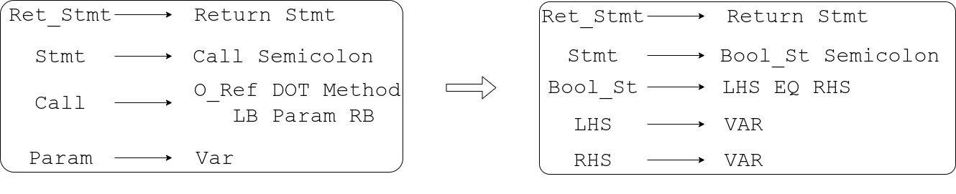
CODIT Step 1 :Tree Translation
Rules sequence of
Syntax Tree before edit
Rules sequence of
Syntax Tree after edit
26
Notes:
Once we have the rules corresponding to the before version and the after version, we use sequence to sequence translator to translate these rule sequence.

Slide 27
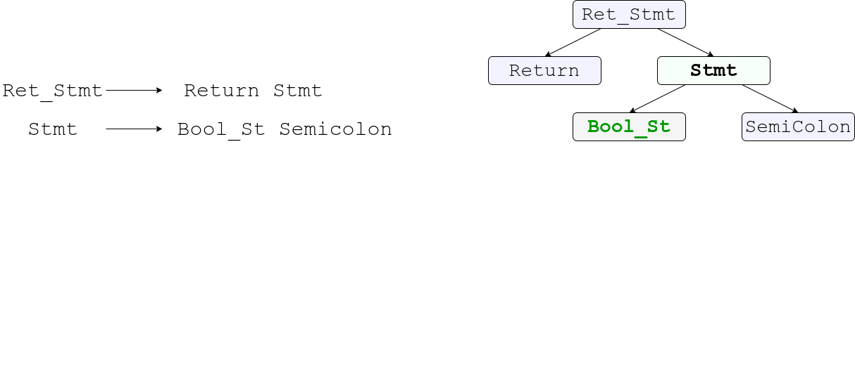
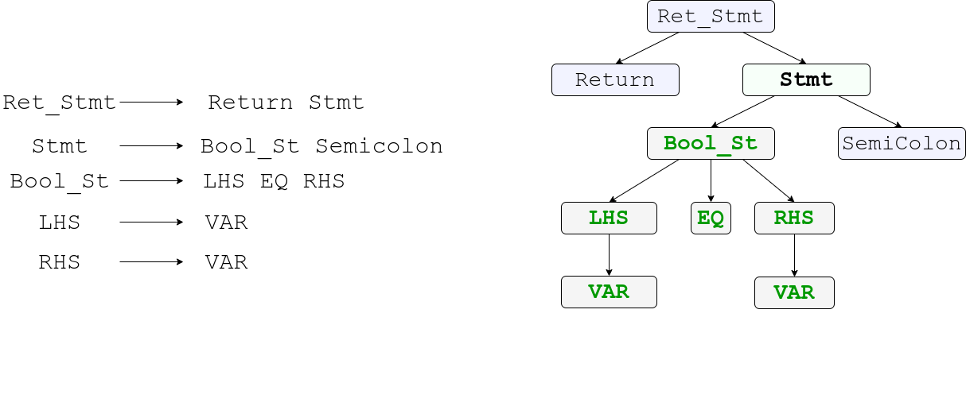
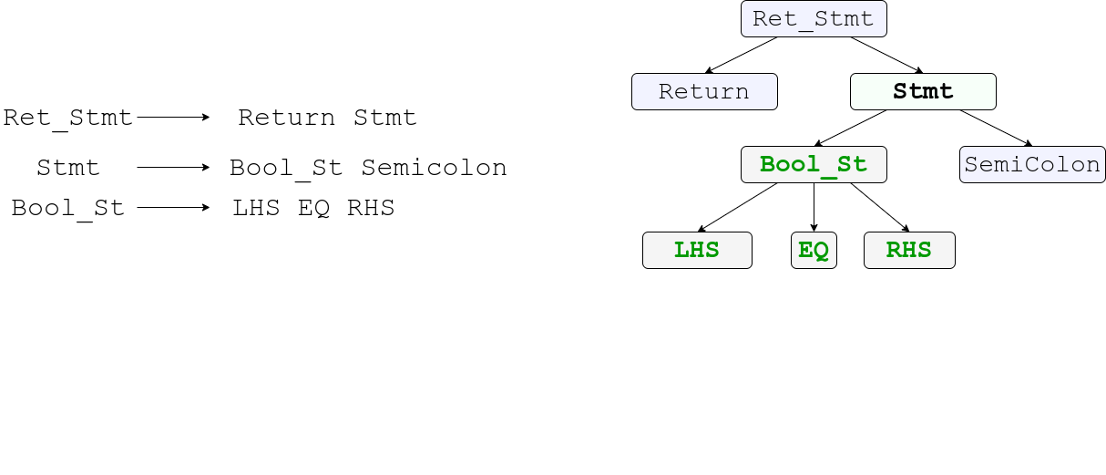
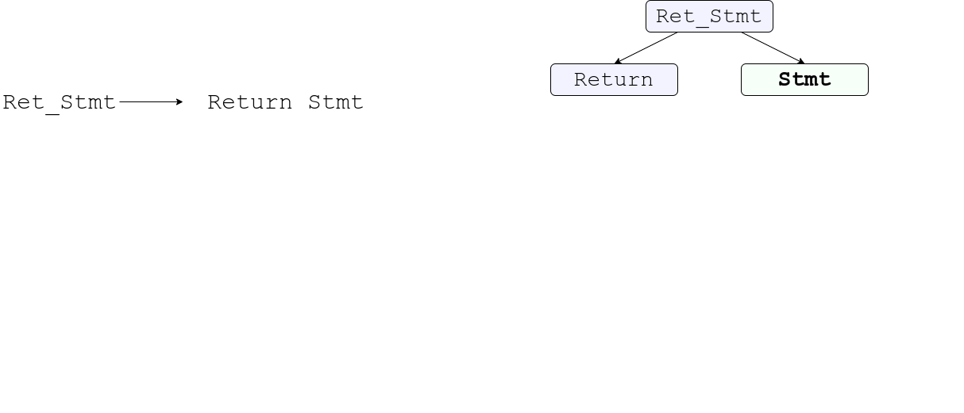
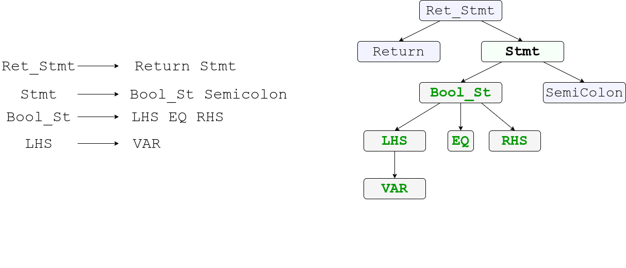
CODIT Step 1 :Tree Translation
27
Notes:
From those generated rule sequence by the rule translator, Codit takes one rule at a time and grows the syntax tree in leftmost derivation fashion.
At every step, CODIT expands the leftmost bottommost non terminal node.
At any point, if the rule head does not match with the node to be expanded,
codit can ignore that rule, or chose an alternative one.
Codit stops when there are no more non-terminal node to be expanded. That is the tree is fully grown.

Slide 28
CODIT Step 1 :Tree Translation
Notes:
Thus, essentially by translating sequence of rule, we are translating the structure of the code and ensuring that the generated structure is syntactically correct.

Slide 29
CODIT Step 2 : Token Translation
Token Translation
Notes:
However, so far we only translated the structure. The full edited code is not ready yet. We still have to populate the terminal nodes with tokens.
To generate tokens, we design a CONDITIONAL token translation model, where we restrict the search space for every token based on the terminal node type from the tree.
For instance, in case of the terminal EQ, the only possible token to generate is the equality operator.

Slide 30

CODIT Step 2 : Token Translation
Reachable Variables in Edit Location:
{inst, object, tmp}
Reachability Analysis in Edit Location
Notes:
However, in case of variables and method names,
it becomes a little bit tricky, since possible number of names of the variable, and methods can be virtually infinite.
To solve this problem, we perform reachability analysis in the Edit location.
We only use those variables and method names that are reachable in the edit location. For instacce, for generating this edit, CODIT only considers these variables.

Slide 31
CODIT: Code Editing With Tree Based Models
Data Set | # of Projects | # of Edit Examples | Code Fragment Size
 |  |  | # of Tokens | # of Nodes
Generic Code Edit from Github | 48 | 32,473 | Max - 38 Avg - 15 | Max - 47 Avg - 20
Pull Request Edits [Tufano et. al. 2019] | 3 | 5546 | Max - 34 Avg - 17 | Max - 47 Avg - 23
Notes:
We evaluated CODIT in these two datasets.

Slide 32
CODIT: Code Editing With Tree Based Models
Method |  | Generic Code Edits | Pull Request Edit
Sequence Based | LSTM-Seq2Seq | 3.77% | 11.26%
 | Tufano et. al. | 6.57% | 23.65%
 | SequenceR | 9.76% | 26.43%
Tree Based | Tree2Seq | 11.04% | 23.49%
 | CODIT | 15.94% | 28.87%
Notes:
Our evaluation results show that CODIT outperforms other techniques including other tree based model because of its ability to generate syntactically correct code.

Slide 33

CODIT – Results
CODIT fixes 15 bugs completely and 10 bugs partially, out of 80 bugs in Defects4j.
Closure Compiler: Bug-3
Notes:
CODIT showed an initial success in Program Repair by fixing 15 bugs completely and 10 bugs partially out of 80 bugs in Defects4j.
Here is an example of Defect4j bugs, where CODIT generated a correct patch.

Slide 34

Explicit Encoding PL knowledge into model
Reachability Analysis
Context Free Grammar
34
Notes:
Now going back to the context of generative model in source code,
We embedded the one formal constraint form programming language THAT IS SYNTAX into the model EXPLICITLY in the form of probabilistic context free grammar and syntax tree.
Which we further improved with reachability analysis. Now that we saw example of Code Generation,

Slide 35
ReVeal (TSE’21) Explicit Encoding of Code Structure for Vulnerability Detection
35
Notes:
Now let us look an example where such explicit encoding can be used for code understanding. In particular, let us see how explicit encoding can help detect vulnerability.

Slide 36






ReVeal
Training Data
Node Features
GGNN
Code Property Graph
Trained ReVeal
Graph Embedding
Notes:
We designed Reveal, a graph based tool to detect vulnerabilities in real world software projects.
Given training data containing vulnerabile and non-vulnerable code, we extract code property graph, which is a graph that encodes all structural relationships between code components.
From the code property graph, we extract initial node features for every node.
Then we use Graph Neural Network to learn the node features from the graph structure.
Once node features are learned, we aggregate those to generate a graph level features
Given a collection of such graph level features, we do resampling to reduce the imbalance bias,
and train our tool ReVeal

Slide 37


ReVeal - Results
ReVeal
F1 score
Token
Based
Graph
Based
[10]
Token
Based
Graph
Based [10]
Chromium & Debian
FFMpeg & Qemu
[10] Devign Zhou et. al. 2019
Notes:
We evaluated ReVeal’s ability to detect vulnerability in two real world vulnerability datasets. The evaluation results show us that
ReVeal and Another Graph Neural Network based model
Devign exhibit higher performances than that of Token based models.

Slide 38



Explicit Encoding PL knowledge into model
Code Property Graph
38
Notes:
If we look closely, In this code understanding task, our input is a code property graph, thus we had to adapt a model that consumes graph. In addition to this, we had to customize the model node embedding based on the content, edge embedding based on type, etc. All of these are PL specific properties, and we are encoding these with a large amount of customization of the model.

Slide 39
Explicit Encoding – Take aways
Code Modeling
Explicit Encoding
Implicit Encoding
Natural Channel Mutation
Formal Channel Mutation
Pros
Precision
Guarantee
Cons
Model design overhead
Transferability
Explainable
39
Notes:
Summing up the portion of Explicit encoding. The good side of explicit encoding is the precision, guarantee, and explainability.
However, these approaches often entails overhead in model design, a lot of customization. Usually a model build for a task under this category, is not easily transferrable to other task. Any further clarification questions?

Slide 40







Implicit Encoding
Code Modeling
Explicit Encoding
Implicit Encoding
Natural Channel Mutation
Formal Channel Mutation
Large Data Corpus
Mutated Input
De-Mutation
[11] CodeBERT – Feng et. al. 2019
[12] GraphCodeBERT – Guo et. al. 2020
[13] CodeX – Chen et. al. 2021
[14] CodeT5 – Wang et. al. 2021
40
Notes:
Now let us see how we can implicitly encode PL properties in the model.
Usually these approaches entails the model learning from large curpus of data in an unsupervised way.
Typically, inputs from the data are mutated or deformed, and model is asked to either identify the deformation or fix the deformation. The idea is that, while doing such localization or repair, model learns about any potential underlying constraints prevalent in the data. This implicit encoding is the motivation behind PRETRAINING large scale models, and couple of such pretrained models are proposed in last few years. All of these models are aiming for better encoding the PL into the model, some with larger quantity of data, some with harder learning objectives etc. Nevertheless, before moving any further, let us go a bit off track and look into the code.

Slide 41


Dual Channel Hypothesis for Source Code [15]
Natural Channel [16]
Formal Channel
[15] Casalanuovo et. al. 2020
[16] Karampatsis et. al. 2020
41
Notes:
Let us revisit the dual channel hypothesis in source code. In source code, there are two information channels.
First there is Natural Channel, consisting of human readable identifiers, readable formatting, comments, etc. This channel is mostly consumed by human developer.
Second, there is Formal channel, consisting of AST, Flow graphs, etc. This channel is mostly consumed by compilers or machines. Anyway, manipulation in the space of different channels will result in different concepts and constraints learned by a model. For instance, if we just remove the semicolons from a correct code and ask the model to fix, the model will only learn the appropriate position for the semicolons.

Slide 42


Implicit Encoding
Code Modeling
Explicit Encoding
Implicit Encoding
Natural Channel Mutation
Formal Channel Mutation
Mutator
42
Notes:
Nevertheless, In implicit encoding let us first look at encoding through natural channel mutation. Here typically while mutating the source code, we just consider the texts of the code, without going in details into the structure or semantics.

Slide 43
PLBART: Unified pretraining Program “Understanding” and “Generation”. (NAACL’21) Implicit Encoding by mutating the natural channel
43
Notes:
In our attempt to pretrain model with natural channel mutation, we designed PLBART, a pretrained model to jointly understand and generate source code.

Slide 44

PLBART – What Is It?
Encoder
Decoder
Pretraining – Unsupervised way of learning code patterns.
Notes:
In a nutshell, PLBART is an encoder-decoder based model which is jointly pretrained to
Both Understand and generate code in an unsupervised way. We trained PLBART using hundred of gigabytes of source code and text.

Slide 45
PLBART – Components
Read Code.
Understands Code.
Reason about any errors in code.
Learns robust representation
Encoder
Decoder
Generate Code.
Learns Coding Patterns.
Notes:
Let us now look at the components of PLBART
The encoder in PLBART reads code, understand, reasons about any error and learn robust representation,
The decoder, on the other hand, learn to generates source code and implicitly learns any coding pattern from the data.

Slide 46

PLBART – Pretraining
Noise Injector
Correct Code
Noisy Code
Decoder
Encoder
PLBART
Token Masking
Token Deletion
Token Infilling
46
Notes:
We train PLBART using denoising autoencoding, an standard way to pretrain encoder-decoder model in NLP
given a code
A noise injector injects noise that could potentially break the syntax of the code
The encoder takes in such noisy code
And the decoder generates back the correct code. In that way, the encoder learns where is the error and what kind error is that, and the decoder learns how to generate error free code.
We use three types of noise function to mutate the natural channel in source code.

Slide 47

PLBART – Jointly Learning to Understand and Generate
Token Masking
PLBART
Notes:
First, we do token masking, we mask out some random tokens from a piece of code, and provide it to
PLBART, which then
Generates the whole code with appropriate tokens for those masked positions.

Slide 48


PLBART – Jointly Learning to Understand and Generate
Token Deletion
PLBART
Notes:
Likewise, For token deletion, we delete some random tokens, and
PLBART,
Generates the whole code including those deleted tokens

Slide 49

PLBART – Jointly Learning to Understand and Generate
Token Infilling
PLBART
Notes:
Token infilling is similar to token deletion, only difference is that, instead of one token, we delete a span of tokens.
And like before, we expect the decoder to generate the whole code including the deleted span.

Slide 50
PLBART – Pretraining
Noise Properties
Mutate Natural Chennel
Likely to Break Syntax
Training Objectives
Generate the whole code.
Learns syntax implicitly
Learn Coding Patterns.
Multi-lingual Training
Java
Python
NL from Stack overflow
50
Notes:
Like we discussed before the noises in PLBART are the mutation of code’s natural channel. and likely to break the syntax of the code.
And the training objective is to generate whole code, learn the syntax implicitly and learn coding patterns.
We pretrained PLBART on source code examples in Java and Python and Natural language texts from stackoverflow.

Slide 51

PLBART – Experiment (Applications)
51
Notes:
A big advantage of pretraining is that models can be reused in many different tasks. We evaluated PLBART on these source code automation tasks. PLBART showed improvements in all these tasks over the baseline methods and models available at the time of publications. Let us look at some interesting Results and Further enhancement of PLBART

Slide 52

PLBART – Results – Code Generation from NL
Dataset: Concode
Metric: EM (exact match %), BLEU-4(max 100), CodeBLEU(max 100)
CodeBLEU =
0.25 * token_match +
0.25 * keywords_match +
0.25 * syntax_match +
0.25 * dataflow_match
52
Notes:
This is the result of PLBART for code generation from natural language specification. Here we evaluated exact match, BLEU score and CodeBLEU score. As we can see from the results, PLBART significantly outperforms other models in terms of COdeBLEU including GPT-2, CodeGPT illustrating PLBART’s ability to implicitly learn the syntax and coding patterns. Note that, these baselines were state of the art at the time of PLBART publication.

Slide 53

PLBART – Search Augmented Code Generation (EMNLP’21)
PLBART
Up to 21% CodeBLEU Improvement Over GraphCodeBERT.
Up to 12% improvement due to Search Augmentation.
53
Notes:
We further improved PLBART on Code Generation with Code Search. Results show this approach results in 21% improvement in terms of CodeBLEU over GraphCodeBERT.

Slide 54

PLBART – Multi Modal Code Edit (ASE’21)
PLBART
Edit Location (Code to be edited), Context, and a Summary of the Edit.
Up to 34% Improvement Over CodeBERT, and 30% Improvement over CodeGPT.
Up to 16% improvement because of Multi-Modality.
54
Notes:
In another application, automated code editing, we applied PLBART in multi-modal code editing. Here we used three different modalities of information to improve code editing. Results show that we achieve 34% improvement over CodeBERT and 30% over CodeGPT, among which 16% improvement is resulting from multi-modality.

Slide 55

PLBART – Results – Code Translation
Dataset: CodeXGLUE [Lu et. al. 2021]
Metric: EM (exact match %), BLEU-4(max 100), CodeBLEU(max 100)
CodeBLEU =
0.25 * token_match +
0.25 * keywords_match +
0.25 * syntax_match +
0.25 * dataflow_match
55
Notes:
Here is the result for PLBART on Code translation between java and C#. And here can also see that PLBART outperforms other techniques models including CodeBERT and GraphCodeBERT.

Slide 56

An interesting example of Code Translation
Input C# Code
PLBART generated
Better Code
56
Notes:
This is an example of Code Translation from C# to Java,
This is the input code. PLBART translated this input C# code to
This code in Java. This is a correct translation of the original C# code.
However, a better translation would be this code.
Because If we have to write a for loop leaving
the initializer and update expression empty in java,
we would rather write a while loop. Since PLBART’s training objective does to account for these kind of semantic equivalent rewriting, PLBART often lacks such capacity.

Slide 57
An interesting example of Code Translation
Input C# Code
Better Code
57
Notes:
However, a better code would be a slightly different, yet semantically equivalent variation of the code.

Slide 58
An interesting example of Code Translation
PLBART’s generation
Better Code
58
Notes:
This is better code, because

Slide 59
Implicit Encoding
Code Modeling
Explicit Encoding
Implicit Encoding
Natural Channel Mutation
Formal Channel Mutation
Mutator
59
Notes:
This brings our next approach in pretraining model. This approach is pretraining through mutation in formal channel.

Slide 60
NatGen: Implicit Encoding by mutating the formal channel
60
Notes:
We are working on designing a pretraining model NatGen which learns to encode PL properties by mutating the formal channel of code.

Slide 61
NatGen: Generative pre-training by “Naturalizing” source code
Write Semantic / Functional Equivalent Code in “More Natural” way
61
Notes:
Our pretraining objective here is to rewrite a code in a way that makes it more natural, preserving the semantics and functionality of the input code.

Slide 62

NatGen: Generative pre-training by “Naturalizing” source code
De-Naturalizing Transformation
62
Notes:
In order to achieve this, we defined several de-naturalizing transformation, to transform a developer written code to make it unnatural and weird.

Slide 63



NatGen: De-Naturalizing Transformations
Confusing Statements [17]
Dead Code Insertion
Operand Swap
[17] Gopstein et. al. 2020
63
Notes:
Here are some examples of denaturalizing transformations we used.
For instance, we used dead code insertion, and asked the model to remove the dead code. Our hypothesis is that, model will learn to implicitly reason about the liveness of the code.
We also add confusing statements and
Swap the arguments of expressions, etc. Nevertheless,

Slide 64
NatGen: Generative pre-training by “Naturalizing” source code
Encoder
Decoder
NatGen
64
Notes:
Then given that weird unnatural code,
We pretraine an encoder decoder model to generate the original natural version. I would like to emphasize here that, the transformations we used to de naturalize code, are all semantic preserving transformations, thus the unnatural code is still syntactically and semantically correct. Arguably, this is a harder task for the models and our expectation is that model will learn how to write better code based on this hard task.

Slide 65

NatGen: Some Initial Results – Few Shot Learning
65
Notes:
Our initial evaluation for NatGen shows enormous promise in different tasks related to code generation when the training data is scarce. In these cases, Natgen generates code that syntactically and semantically closer to that of developers’ written code compared to another large pretrained model that is CodeT5.

Slide 66
Explicit Encoding – Take aways
Code Modeling
Explicit Encoding
Implicit Encoding
Natural Channel Mutation
Formal Channel Mutation
Pros
Little overhead
Cons
No Guarantee
Unsupervised
Transferable
Potential Bias from Mutation
66
Notes:
Nevertheless, advantage of Implicit encoding includes very little overhead, unsupervised and transferable nature of such.
On the other hand, there is no guarantee of the learned knowledge because of the opaque nature of the large scale models. And there could be potential biases from the mutations.

Slide 67


My Research Applications
Programming Language Processing
Code Summarization
NeuralCodeSum (ACL’20), PLBART (NAACL’21)
Vulnerability Detection
ReVeal(TSE’21), DISCO(ACL’22)
Code Editing
CODIT (TSE’20), MODIT(ASE’21), DiffBERT (Facebook)
PLP
Code Generation and Translation
PLBART (NAACL’21), SNG-PLBART(NAACL’22 - under review), DataTypeLM ForCode (ACL’18).
Code Search and Synthesis
RedCoder (EMNLP’21), CodePanda (W.I.P)
67
Notes:
Now to summarize, I have applied my research in Programming Language Processing in different applications. including
Code summarization
Vulnerability Detection
Code Editing
Code generation and translations
And finally Code Search and Synthesis

Slide 68





What’s Next? (Short Term Goal)
API driven Program Synthesis
Improving Semantic Code Search with RL
Synthesizer
I/O Similarity
68
Notes:
I am currently working on several projects. Including API driven program synthesis
And Improving Semantic Code Search with RL.

Slide 69


What’s Next? (Short Term Goal)
Representing Code Context as Dynamic Graph
Learning Code Syntax and Semantics with Reinforcement Learning (RL)
Other Information Modalities
Other Software Metadata – Comments, Commits, Code Evolution metadata.
Analysis of Program Binaries.
Dynamic Analysis of Program – based on execution behavior.
69
Notes:
In Near future I plan to work in learning syntax and semantic through RL
Learning to represent Code context as a hierarchical dynamic graph.
My another short term goal is investigate other modes of code, for examples, meta data, binaries, traces, etc.

Slide 70







What’s Next? (Long Term Goal)
Code Generation
Formal Analysis
Probabilistic models
Guarantee for the Analysis
Scalable and Transferrable
Noise Intolerant
No theoretical Guarantee
Developer Feedback Oriented Automation
70
Notes:
In long term, my goal is to work on pushing the
boundary of code generation by moving simultaeneously from formal analysis perspective and probabilistic models’ perspective.
And meet somewhere in the middle of the spectrum.
My another long term goal is to incorporate developers’ feedback into the model and further improving the model by rewarding or penalizing based on the feedback from developers.

Slide 71











Baishakhi Ray
Adviser
Wasi Ahmad
UCLA / Amazon
Miltos Allanmanis
MSR
Kai-Wei Chang
UCLA
Yanju Chen
UCSB
Prem Devanbu
UC Davis
Yangruibo Ding
Columbia
Yu Feng
UCSB
Rahul Krishna
Columbia / IBM
Toufiq Parag
UC Davis
Rizwan Parvez
UCLA
71
Notes:
I express my gratitude to my Ph.D. adviser Dr. Baishakhi Ray and
My amazing collaborators for their support.

Slide 72
Thanks!
72
Notes:
Thanks for attending the talk, I will be happy to answer any further questions.

Slide 73
Source Code Understanding
Learning to Reason About Vulnerabilities in Source Code
73
Notes:
In this portion of the talk, I will discuss source code understanding model, in particular, I will discuss about how these models reason about vulnerabilities in source code.

Slide 74
Backup slides

Slide 75


Source Code Properties - Functionality
75
Notes:
The requirement for models to understand the functionality is very crucial.
Since Drastically different looking code can be functionally equivalent. A good model should be able to identify these code as similar.

Slide 76

PLBART – Application
Multi-Modal Code Editing MODIT (ASE’21)
76
Notes:
We subsequently applied PLBART for Automated Code Editing. In particular, we used PLBART for Multi-Modal code editing which is published in ASE 2021. Here, given a piece of code
The edit location
And a description of edit
Our goal is to generate the edited code. We use three different information modality in this work. First the code needs to be edited, second the surrounding context, and finally the guidance in the form of edit description.

Slide 77


PLBART – Application
Multi-Modal Code Editing MODIT (ASE’21)
Results
Dataset
77
Notes:
We evaluated PLBART on two bug fix code editing dataset. And results show that MODIT outperforms all other models including CODIT, and other pretrained mdoels in both Unimodal and Multi-modal settings.

Slide 78




PLBART Application - REDCODER
Search Augmented Code Generation (EMNLP’21)
78
Notes:
In another application, we used PLBART for search aurgmented Code generation. This pape ris published in EMNLP findings in 2021.
Here, we investigated whether Code Search can improve Code Generation’s performance. In particular, we investigate given a query,
if we find an approximately correct code,
whether we can generate the expected code using PLBART

Slide 79

PLBART Application - REDCODER
Search Augmented Code Generation (EMNLP’21)
79
Notes:
In this work, given the query, we first searc related code from open source database

Slide 80

PLBART Application - REDCODER
Search Augmented Code Generation (EMNLP’21)
PLBART
80
Notes:
Then we use the query and the retrieved code from the search as the input of encoder-decoder model to generate the final code.
The encoder-decoder model we use here is, of course, PLBART.

Slide 81

PLBART Application - REDCODER
Search Augmented Code Generation (EMNLP’21)
Dataset: Concode
Metric:
EM (exact match %),
BLEU-4(max 100), CodeBLEU(max 100)
CodeBLEU =
0.25 * token_match +
0.25 * keywords_match +
0.25 * syntax_match +
0.25 * dataflow_match
81
Notes:
Here is the result of REDCODER in code generation. As the results show, REDCODER outperforms other technique in this code generation task.

Slide 82



Source Code Properties - Functionality
82
Notes:
And a very slightly different code could functionally very different than the original code. A good model aimed at reasoning about functionality should identify, focus and reason about such tiny difference with potentially huge impact on code functionality. Now that we know about what to expect from the model, let us look what will happen if we are to use a off-the-shelf model from other domain.

Slide 83



Vulnerability – an example
83
Notes:
Here we are seeing an example of vulnerable code
The source of the vulnerability is these three invocation of sprint function and
Unsafe use of buffer in these function calls. We used an off the shelf CNN model trained on vulnerability datasets to classify this code.

Slide 84

Vulnerability – an example
84
Notes:
To our surprise, the model in question correctly classified this function as vulnerability.
However, when we dug deep, we found that the CNN model is doing the right thing for the wrong reason. In particular, the model thinks these portion of the code highlighted in red is the reason for this code being vulnerable. Obviously, this portion of code has little to nothing to do with the actual vulnerability.

Slide 85


Vulnerability Detection – in the wild
*Chromium
and
*Debian
FFMPeg
and
Qemu
* Collected from Issue tracers (Jira, BugZilla) of corresponding projects.
Notes:
To push even further, we applied some of the vulnerability detection techniques to indetify vulnerabilities in real world dataset.
We deployed some existing toold for two real world vulnerability datasets. The first datset contains vulnerable and benign code from Chromium and Debian projects, which we collected from the corresponding projects’ issue trackers.
Another dataset is real world vulnerabilities from FFMPeg and Qemu. As we can see, the performance is so low that it is on the verge of being useless. Even when we retrained these techniques on portion of these datasets, the performance is not that high. Our hypothesis was that these models are not capable enough to reason about some of the desired properties we discussed earlier.

Slide 86


Learning Function Properties
Functionally Equivalent
Positive Contrast
Functionally Different
Negative Contrast
Notes:
As for equipping model with reasoning capacity about functionality, we resort to learning from contrast.
In particular, given a code, we generate its functional equivalent positive contrast, and
Functionally different negative contrast.

Slide 87
Explicit Encoding – Always feasible?
Calling context / Class
Data Type
Object Type
Overloaded Functions
87
Notes:
However, explicit encoding of all formal properties may not always be feasible. As an example, let us consider explicitly encoding the type correctness formal property.
To encode such, we would have to encode the object data type in to the grammar.
We would have to account for other overloaded versions of the callee functions
Same goes for the type checking of the call parameters.
Most importantly, we will have to encode the calling context THAT IS the method, the class, the package, etc. into the grammar. Our conjecture is that, if we want to account for all these type checks in the form of a grammar, the size of the grammar might be intractable. There is an easy way to ensure these type safety. We could leave these type checks as a post-processing steps and filter out all the editd code that are violates contextual requirement for data types. But, we are worrid that model would make too much such mistake, and we would have to waste a lot of effort checking for these cases. To make sure model does have some inherent capacity of generating correct types, let us look a bit in depth into the model.

Slide 88

Deep Into The Model!
Language Model
Task Model
Language Model
Notes:
For a model to transform any input to output, there are
Two implicit sub-model working in synergy
The first sub-model is for reasoning about the language
And the other one is for reasoning about the task. Although, in all fairness, there is no strict separation between these sub-models, but conceptually we can sub-divide any model in this way.
If we look closely, this language model is not tied to any particular task and thus amenable to transfer across different tasks.

Slide 89
Encoding PL knowlwdge into model - Implicit
89
Notes:
Since this language model is not dependent on the task, we can embed knowledge about PL implicitly into the model. Such knowledge can be extracted from huge code based provided by open source repositories. Also, since we are also interested in transferring PL knowledge across different tasks, we need an uniform model suitable for a wide variety of tasks. With all these motivations,

Slide 90

DISCO (ACL’22) - Learning Function Properties
Notes:
We pretrain a transformer based model in a way that brings the positive contrast closer in vector space, and push the negative contrast and other unrelated code further away from the original code.

Slide 91

DISCO (ACL’22) – Results (Chromium and Debian)
DISCO 48.3 44.6 46.4
Notes:
As we see the evaluation of DISCO on Chromium and Debian dataset, we see the DISCO does not only outperform our earlier work ReVeal, but also other pretrained models including CodeBERT, GraphCodeBERT, etc.

Slide 92
1. Representation Learning
PLBART (NAACL’21),
DISCO (ACl’22)
4. Execution Behavior Learning
- Future Work
Understanding
Models
3. Functionality Learning
DISCO (ACL’22)
2. Code Structure Learning
ReVeal (TSE’21)
Notes:
Thus, to summarize my works on source code understanding models.
I worked on Representation learning, that is PLBART and BOOST
Code Structure learning , that is ReVeal
Code Functionality learning that is DISCO.

Slide 93






Average Time Spent by Software Engineers
Ray et. al. ICSE’16,
Hindle et. al. CACM’16
Coding
Testing
Jiminez et. al. ESEM’18
Writing Code and
Improving Existing Code.
Writing Test Cases, Mutation Testing, Running Test Suites.
67% of Total Time
Dealing with
Source Code
Meng et. al. ICSE ’13, ‘15
Code Maintenance
Security
Li et. al. NDSS’18
Refactoring, Maintaining
Existing Code
Identification and Analysis of Security Issues
Management
Others
Meetings, Administrative,
Managerial tasks.
93
https://thenewstack.io/how-much-time-do-developers-spend-actually-writing-code/

Slide 94



Why Vulnerability Detection?
CVE: Common Vulnerability Enumeration
National Vulnerability Database - 17 November 2021
Report published by Positive Technologies
(https://www.ptsecurity.com/ww-en/analytics/web-vulnerabilities-2020/)
Notes:
Vulnerability: Weakness of the computer systems. A snapshot statistics of National Vulnerability Database showed as of November 17 2021, there are 17630 vulnerabilities reported.
In fact, in November 2021 alone, about 17 hundred vulnerabilities are reported.

Slide 95
Relative Cost of Bug Fixing
30x
25x
20x
15x
10x
5x
0x
50%
55%
60%
65%
Requirement/
Architecture
Coding/
Unit Testing
Integration
Testing
System
Testing
Production/
Post-Release
95

Slide 96



Example Edits
Addition
Deletion
Update

